Slide 1



4th International Conference on Mechanics of Advanced Materials and Structures
(ICMAMS 2024)
Sand Inclusion Composite Structures for Enhanced Ballistic Impact Resistance
Presented By: Nishika Nakka, IIT Ropar
Contributors : Nishika Nakka, Sai Sahasra Surkanti, Bommiditha Jyothsnavi, Manas Thakur, Srikant Sekhar Padhee
Department of Mechanical Engineering
Indian Institute of Technology, Ropar

Slide 2
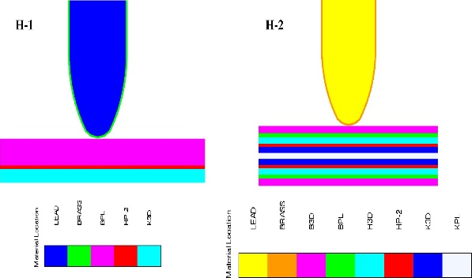
MOTIVATION
Fiber- Reinforced Polymers (FRP’s)
Superior Protection while maintaining a lightweight profile.
Dissipation of Kinetic Energy over a larger area incorporating effective stacking sequence.
Tailor ability by virtue of constituent elements (Fiber, matrix, etc)
Multi-hit capability and ability to integrate with ceramics with maintaining S-W ratio.

Slide 3
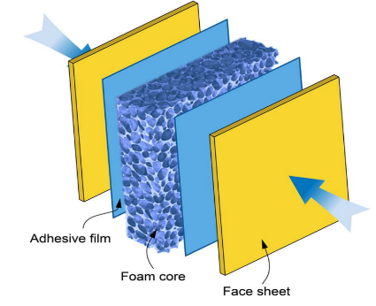
MOTIVATION
Energy Absorbing Structures
CMFs provide high energy absorption per unit area with good thermal and acoustic insulation.
Corrugated sheets have high bending stiffness and are easily integrable.
Origami and honeycomb structures provide tuneable properties via geometric design with a high S-W ratio.

Slide 4
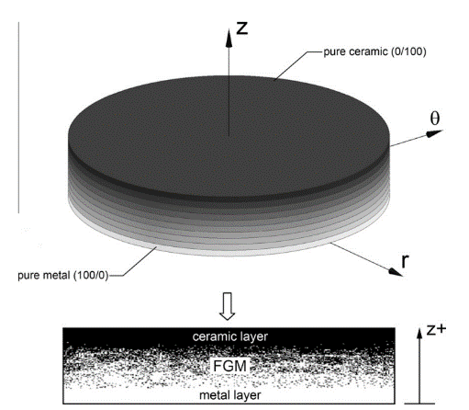
MOTIVATION
Functionally Graded Materials
Novel class of material providing gradients in Material Properties.
Provides improvised shock-impedance characteristics required in different layers combined.
Reduced delamination and improvised multi-hit capability thereby mitigating localized stresses.

Slide 5
Layered Systems Issues
Structure
Denser, Stiffer and brittle region for Initial Impact resistance (Tip Deterioration)
Transferred Energy Absorption and K.E. dissipation
Cushioning effect and prevents backlash
Fiber Reinforced Composites
Aluminum Backing
Ceramics, RHA Sheets, etc.
CMF, Origami Structures, Corrugations, etc.
Major Issues (FRC)
Delamination, Matrix Cracking, Fiber Failure
Moisture Sensitive e.g. aramid fibers
Complexity in Manufacturing
Cost
Major Issues
Limited-Multi hit Capacity
Requires Strong Backing
Heavier and Cost-Ineffective
Major Issues
Manufacturing Complexity
Low Multi-Hit (deformed cells)
Density vs Energy Absorption

Slide 6
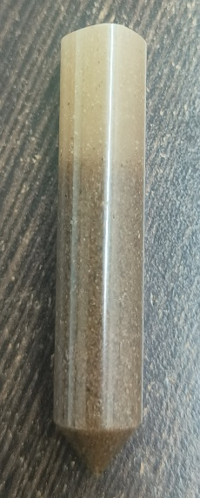
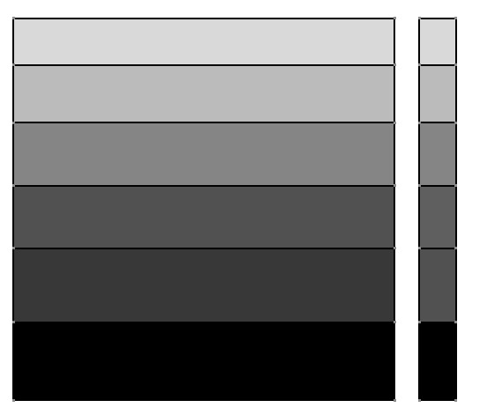


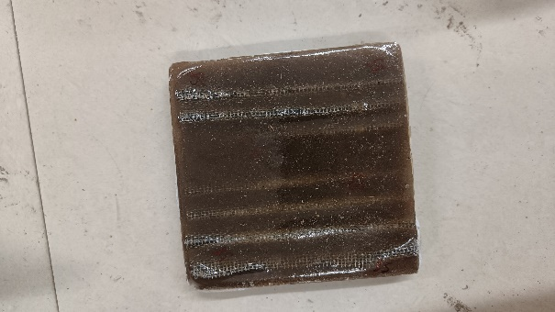
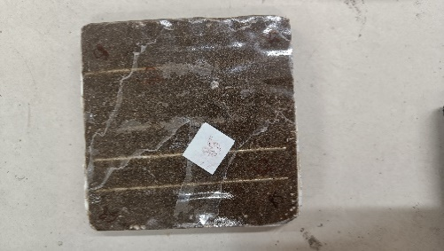
Conceptualization
Barely Dense or Neat Matrix Region Providing Cushioning Effect(Preventing Backlash)
Corrugated Mesh
Less Dense Region Providing Backing to Absorb Residual Energy
Corrugated GI/Al Sheets
Densely Graded Layer Providing Initial Impact Absorption and Abrasive Bullet Tip Deterioration (Harder + Abrasive Wear)
Projectile
Sand Inclusions
Major Advantages
Sand particles increased the surface area resulting in better bonding
The abrasive nature of sand provides initial tip deterioration
Tailorable directional properties by varying particle size and fraction
Corrugated sheets act as stiff barriers or energy-absorbent mesh sheets at the end provide energy transfer to a larger area
Comparatively low cost, lightweight (Ceramics and metals), and manufacturing suitable structures.

Slide 7
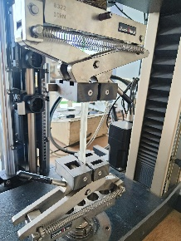
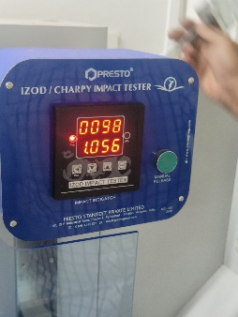
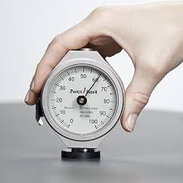
Methodology
Experiment 1
ER099 Epoxy
Sand Pre-Processing
Mold Preparation
Sample Preparation
Post Curing
LY556 Epoxy
Experiment 2
Battery Of Tests
(Uniform Distribution of sand)
Tensile Test
I-Zod Impact Test
Shore D Hardness Test

Slide 8
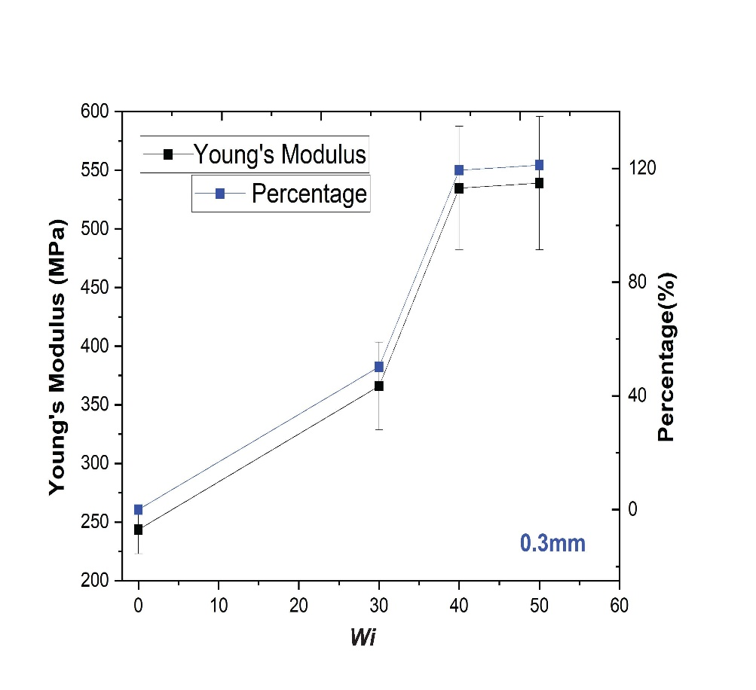
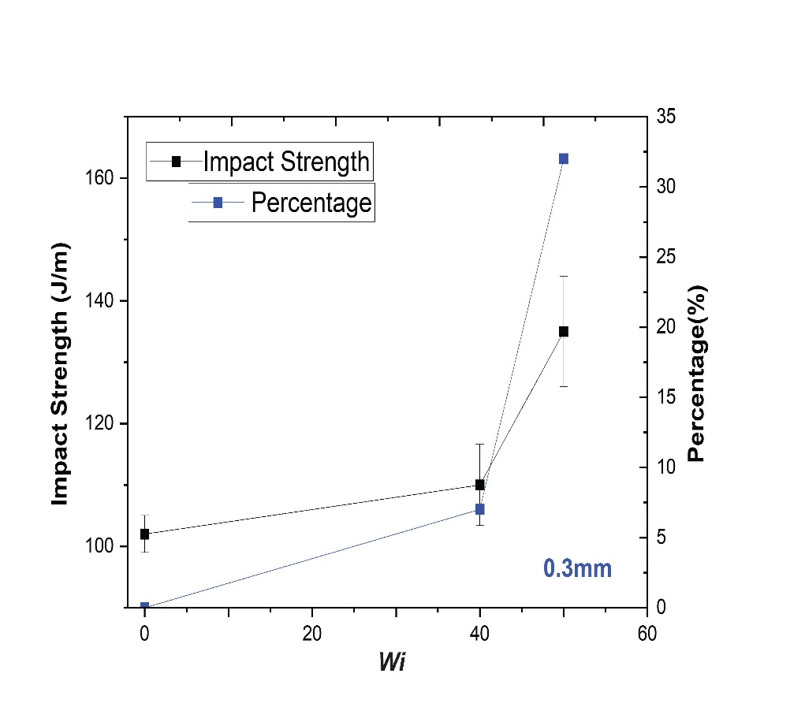
ER099 Epoxy Test Results
Tensile and Impact Test Results
Drawbacks
Settling of sand
Insufficient bonding
Increased Shrinking
Increased Trapped air
Mechanical strength affected by post-curing.
30% sand – 360MPa (46% increase)
40% sand – 545MPa (120% increase)
50% sand – 550MPa (125% increase)
40% sand – 110 J/m (7% increase)
50% sand – 135 J/m (32% increase)

Slide 9
LY556 Epoxy Test Results
Tensile Test
Impact Test
Shore D Hardness Test
Outcomes
0.3mm(70%sand) – 1810MPa
0.425mm(60%)- 1445Mpa and drop at 70% (agglomeration)
Outcomes
0.3mm (70%) –210J/m
0.425mm (60%) –100 J/m
0.6mm (70%) – 150 J/m
Outcomes
0.3 mm (70% sand) – 83.5
0.425 mm (70% sand) -89
0.6 mm (70% sand) – 92.5

Slide 10
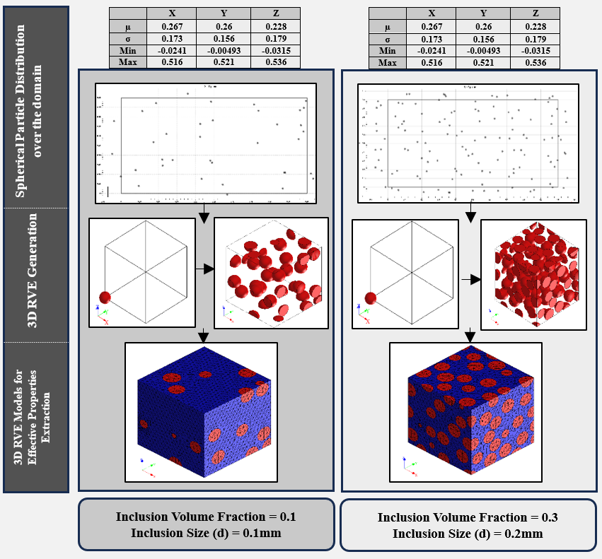
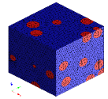
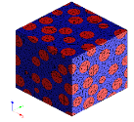
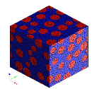
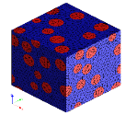
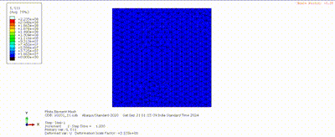
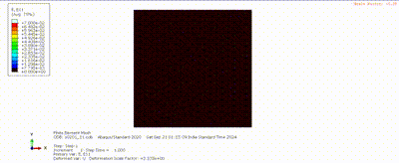
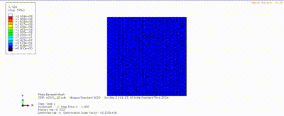
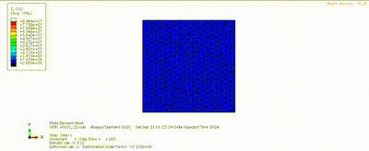
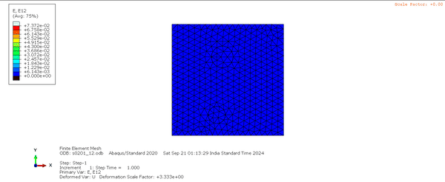
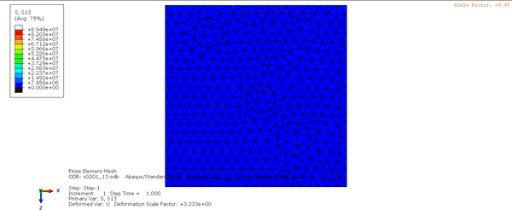
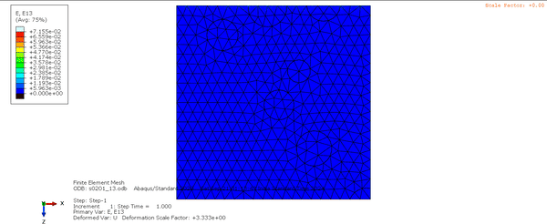
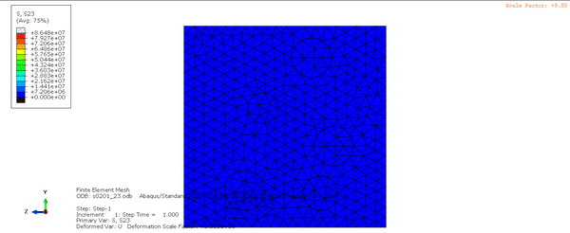

Effective Properties Extraction
RVE Modelling
BCs For Effective Properties Extraction
Typical Finalized Models of RVE
Imposed BCs to Evaluate Stresses and Strains in Respected Directions and Planes
S₁₁
S₁₂
E₁₁
E₁₂
S₂₂
S₁₃
E₂₂
E₁₃
S₃₃
S₂₃
E₃₃
E₂₃

Slide 11
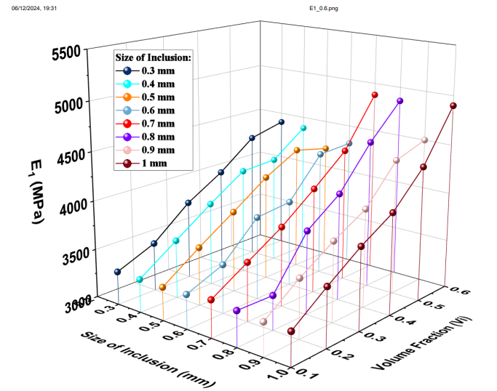
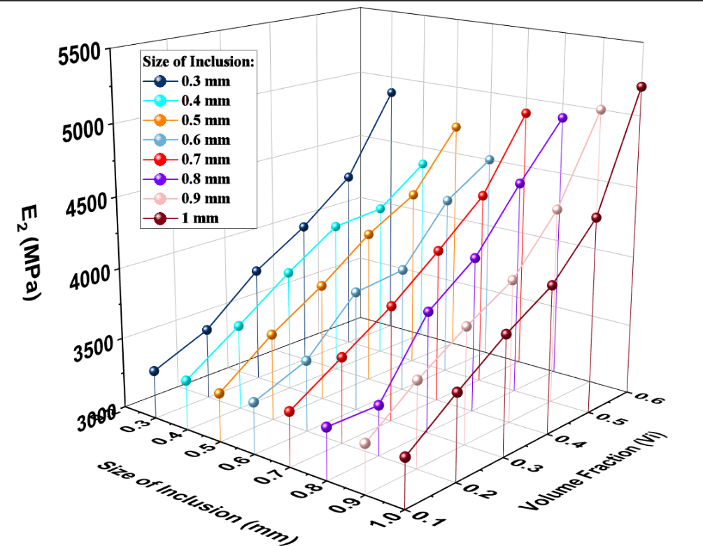
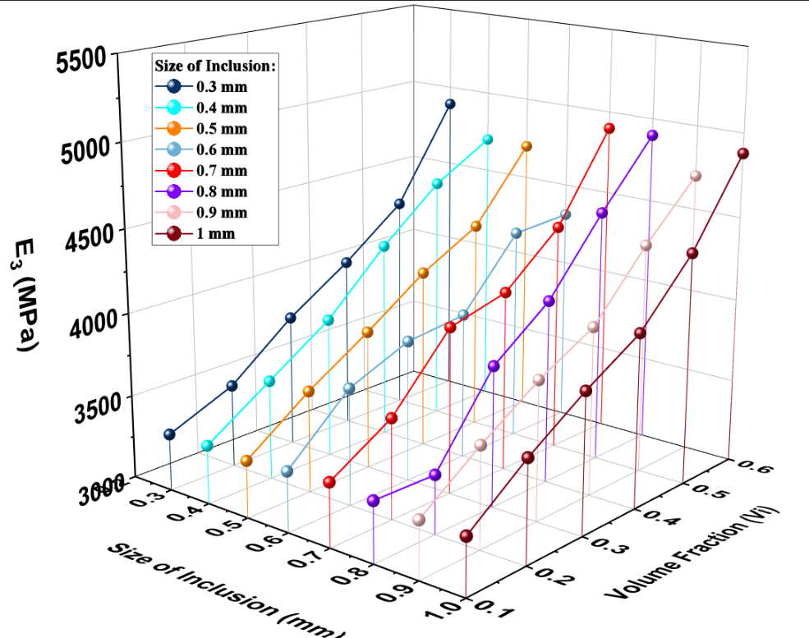
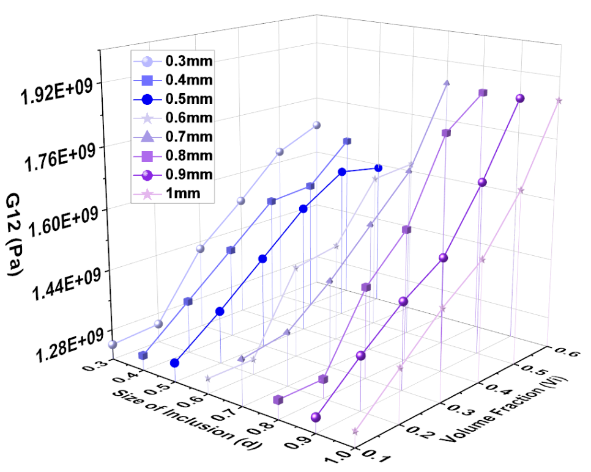
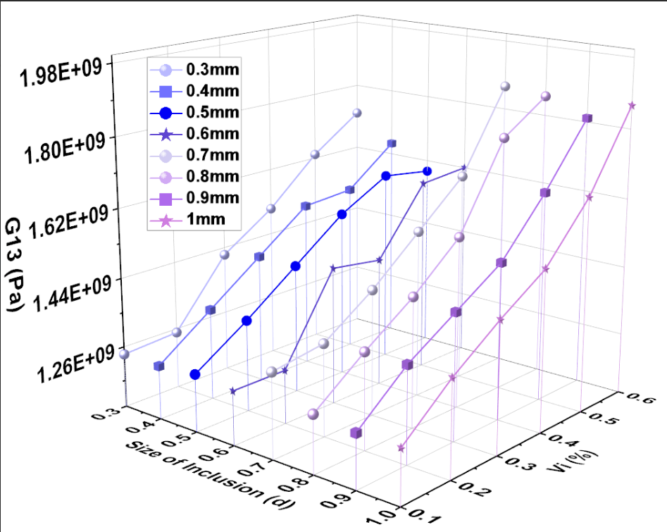
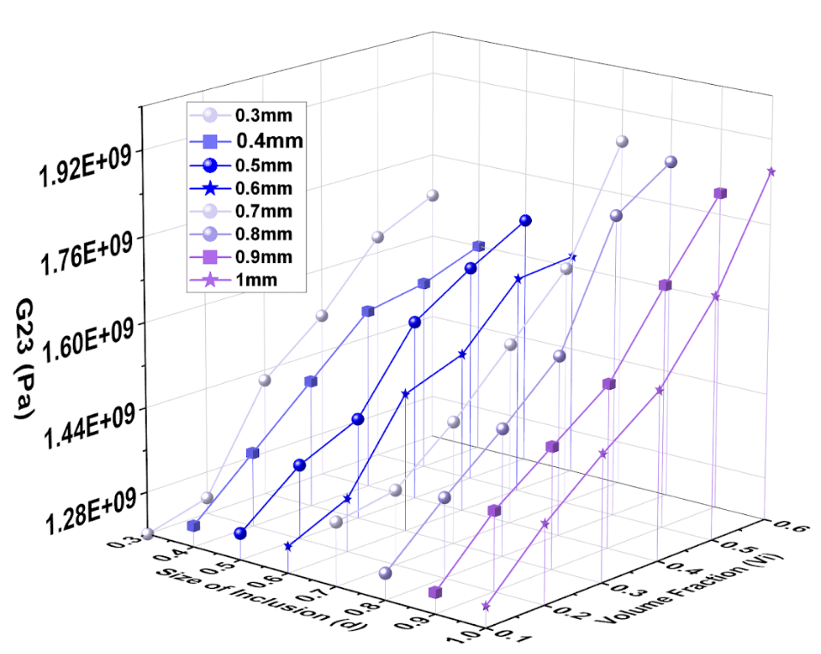
Simulation Studies Results and Findings
Significant increase in the elastic moduli (E1,E2,E3) was observed with increase in diameter and composition
A notable increase in shear modulus (G12, G23, G13) was observed with larger inclusion size and volume fraction.

Slide 12
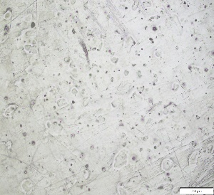
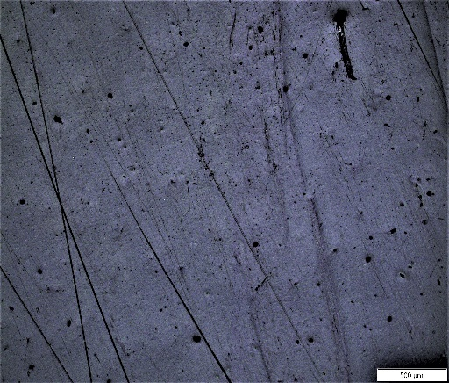
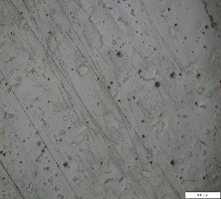
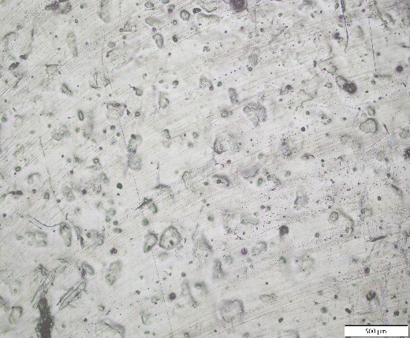
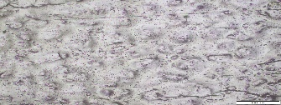
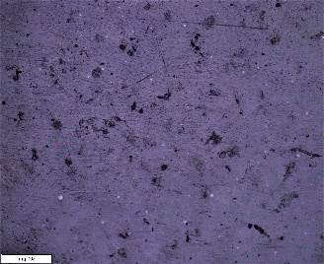
Microstructural Analysis
a)
Agglomeration
0.425mm, 20%
b)
0.425mm, 30%
Observations :
The refined manufacturing process enabled a more uniform sand distribution up to a certain limit
Fewer agglomerations in small grain sizes and lower weight fractions a),b).
Larger Particles did not increased agglomerations although higher percentages increased agglomerations d).
Voids were lower owing to minor inconsistency in filling or dispersion c).
Denser sand regions and weak matrix regions are observed when increased percentage of sand.
Agglomeration
Sand Particles
Voids
500 µm
500 µm
0.425mm, 40%
c)
d)
0.425mm, 50%
Sand Particles
Voids
Agglomeration
Sand Particles
Voids
Agglomeration
500 µm
500 µm
e)
0.6mm, 40%
0.6mm, 60%
f)
Sand Particles
Denser Regions
Sand Particles
Denser Regions
Crack
Weaker Matrix Regions
500 µm
500 µm

Slide 13
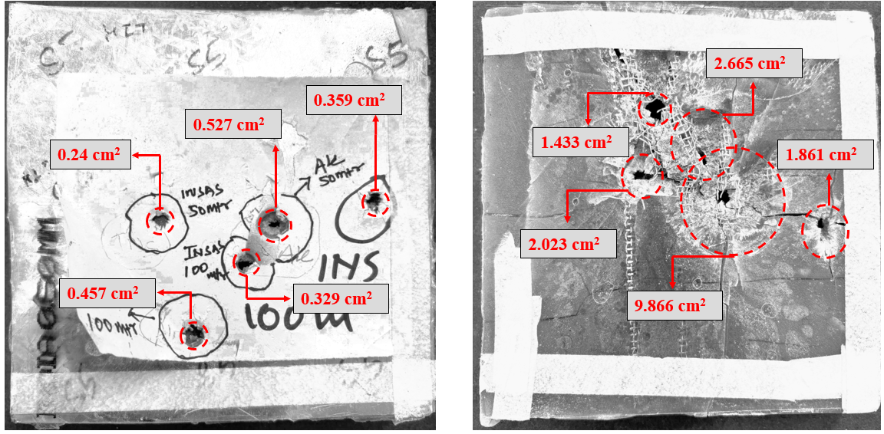
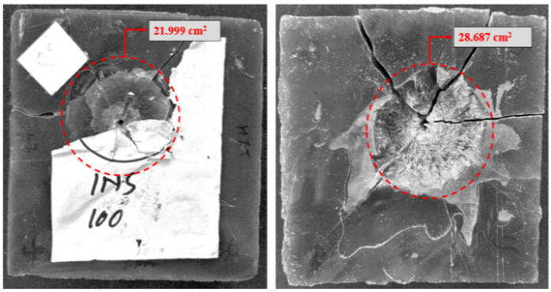
Preliminary Projectile Impact Studies
Projectile Impact Results
Assertions:
Both samples were subjected to ballistic testing using an INSAS rifle from a distance of 100m.
Sample LY15_05 showed a larger bullet impact area compared to sample ER20_05.
Corrugated Mesh Limited Fragmentation upon Multi-hit.
LY20_05 had more visible cracks, suggesting it absorbed more impact energy due to crack propagation.
ER, EH grade
t=20mm
d=0.6mm
wi=0.5,0.3
1 GI Sheets, 1Mesh
Front Face ER20-05 Back Face ER20-05
LY, HY grade
t=15 mm
d=0.6mm
wi=0.5,0.3
1GI Sheet, 1 Mesh
Front Face LY15-05 Back Face LY15-05

Slide 14
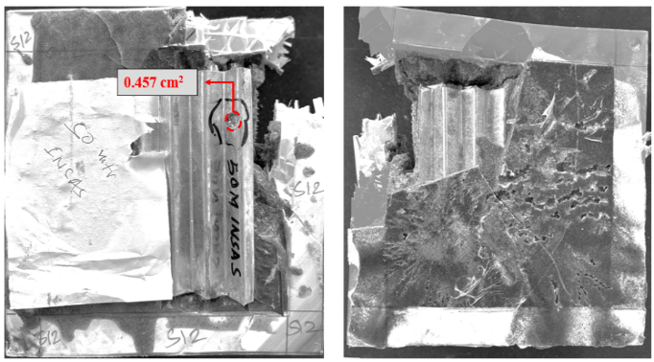
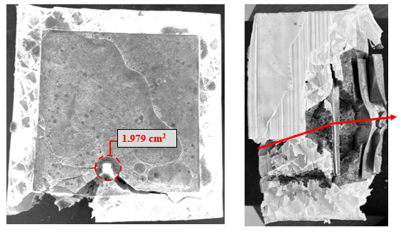
Preliminary Projectile Impact Studies
Projectile Impact Results
Assertions:
Sample in the first figure, Ballistic testing using an INSAS rifle at 50m. The sample showed incomplete penetration up to two shots fired and further delamination due to increased layering.
The sample in the second figure was tested with an SIG rifle at 50m. The sample showed bullet’s trajectory deflection resulting due to alternate corrugations.
An increased damage along the thickness suggests the dominant effect of layering in structure with bullet deuteriation as a major contributor.
LY, HY grade
t=80 mm
d=0.425mm
3 GI corrugated
1 Mesh corrugated
Front Face LY80-04_2 Back Face LY80_04_2
LY, HY grade
t=80 mm
d=0.425mm
2 GI corrugated
2 Mesh corrugated.
Front Face LY80-04_1 Side Face LY80_04_1

Slide 15
Conclusion
An appropriate polymer matrix was selected by incorporating experimental procedures.
The manufacturing process was refined by implementing thorough empirical procedures in order to achieve consistent optimal results.
An increase in Young’s modulus, Impact Strength, and hardness was observed via experimental tests.
In order to get a broader prospect of the material behavior upon variation in constituent elements, homogenization was performed on different RVEs.
With increase in inclusion size and volume fraction an increase in Young’s modulus and the shear modulus was observed.
Ballistic tests were carried out on samples made with epoxy grades LY556 and ER099 with unique configurations and the samples made of LY556 exhibited a larger impact area due to their higher stiffness, leading to enhanced impact absorption compared to ER-099 samples. However, an increase in the number of layers resulted in observed delamination due to elevated stress concentration at the interfaces.

Slide 16
References
[1] Marx, J., Portanova, M. and Rabiei, A., 2020. Performance of composite metal foam armors against various threat sizes. Journal of Composites Science, 4(4), p.176.
[2] Wadley, H.N.G., Dharmasena, K.P., O'Masta, M.R. and Wetzel, J.J., 2013. Impact response of aluminum corrugated core sandwich panels. International Journal of Impact Engineering, 62, pp.114-128.
[3] Cui, T., Zhang, J., Li, K., Peng, J., Chen, H., Qin, Q. and Poh, L.H., 2022. Ballistic limit of sandwich plates with a metal foam core. Journal of Applied Mechanics, 89(2), p.021006.
[4] Gellert, E.P., Cimpoeru, S.J. and Woodward, R.L., 2000. A study of the effect of target thickness on the ballistic perforation of glass-fibre-reinforced plastic composites. International Journal of Impact Engineering, 24(5), pp.445-456.
[5] Reddy, P.R.S., Reddy, T.S., Mogulanna, K., Srikanth, I., Madhu, V. and Rao, K.V., 2017. Ballistic impact studies on carbon and E-glass fibre based hybrid composite laminates. Procedia engineering, 173, pp.293-298.
[6] Wambua, P., Ivens, J. and Verpoest, I., 2003. Natural fibres: can they replace glass in fibre reinforced plastics?. Composites science and technology, 63(9), pp.1259-1264.
[7] ] Zemani, K., May, A., Khatir, S., Gilson, L., Cuong-Le, T., Wahab, M.A. and Slamani, H., 2024. Numerical analysis of an experimental ballistic test of Al/SiC functionally graded materi als. Composite Structures, 333, p.117909.
[8] Etemadi, E., Khatibi, A.A. and Takaffoli, M., 2009. 3D finite element simulation of sandwich panels with a functionally graded core subjected to low velocity impact. Composite Struc-tures, 89(1), pp.28-34.
[9] Akbar, H.I., Surojo, E., Ariawan, D., Prabowo, A.R. and Imanullah, F., 2021. Fabrication of AA6061-sea sand composite and analysis of its properties. Heliyon, 7(8).
[10] Kumar, T.S., Joladarashi, S., Kulkarni, S.M. and Doddamani, S., 2024. Influence of sea sand reinforcement on the static and dynamic properties of functionally graded epoxy composites. Iranian Polymer Journal, pp.1-18.
[11] Shi, J., Chen, D. and Yu, Z., 2024. Novel epoxy resin-bonded sand system: Mechanical strength, deterioration resistance, and failure mechanism. Engineering Failure Analysis, 158, p.108020.
[12] https://www.farix.hu/pdf/1360669728.pdf
[13] Molina, O., Vilarrasa, V. and Zeidouni, M., 2017. Geologic carbon storage for shale gas recovery. Energy Procedia, 114, pp.5748-5760. [14] Murthy, V.C.A.D. and Santhanakrishnanan, S., 2020. Isogrid lattice structure for armouring applications. Procedia Manufacturing, 48, pp.e1-e11.
[15] Kapoor, S., Ray, S., Sahoo, J.P. and Joshi, Y.K., 2024. Optimization of multi-layered composites against ballistic impact: A mesoscale approach. Composite Structures, 338, p.118097.

Slide 17

THANK YOU

Slide 18
Materials
Material Properties the Johnson-Cook (JC) material the model used in the Computational model derived from [14]
Element Deletion parameters given to PMSCs Extracted from Uni-axial tensile test.
Parameter | Description | AISI 4340
D1 | Failure Parameter | 0.05
D2 | Failure Parameter | 3.44
D3 | Failure Parameter | -2.12
D4 | Failure Parameter | 0.002
D5 | Failure Parameter | 0.61
Þ (kg^m-3) | Density | 7830
E (GPa) | Young's Modulus | 205
A (MPa) | Yield Stress | 792
B (MPa) | Hardening Constant | 510
n | Hardening Exponent | 0.26
c | Strain Rate Constant | 0.014
m | Temperature Softening Exponent | 1.03
Tm (K) | Melting Temperature | 1519.9
ϵ (s^-1) | Reference Strain Rate | 1
Tr (K) | Reference Temperature | 22
wi | Size | E(Pa) | µ | Global Density rho | Yield Stress (Pa) | Plastic Strain | Stress Triaxiality | Displacement at Failure
0.2 | 0.425 | 1.21E+09 | 0.35 | 1216.446 | 2.01E+07 | 0.019 | 0.33 | 2.30E-03
 |  |  |  |  | 2.15E+07 | 0.02
0.3 | 0.425 | 1.31E+09 | 0.35 | 1224.839 | 2.59E+07 | 0.029 | 0.33 | 3.40E-03
 |  |  |  |  | 2.67E+07 | 0.03
0.4 | 0.425 | 1.33E+09 | 0.35 | 1233.349 | 3.16E+07 | 0.0255 | 0.33 | 3.20E-03
 |  |  |  |  | 3.29E+07 | 0.0275
0.5 | 0.425 | 1.38E+09 | 0.35 | 1241.978 | 3.67E+07 | 0.03 | 0.33 | 3.50E-03
 |  |  |  |  | 3.77E+07 | 0.031
0.6 | 0.425 | 1.49E+09 | 0.35 | 1250.729 | 4.05E+07 | 0.032 | 0.33 | 3.80E-03
 |  |  |  |  | 4.15E+07 | 0.034
0.7 | 0.425 | 1.11E+09 | 0.35 | 1259.604 | 1.27E+07 | 0.0139 | 0.33 | 1.60E-03
 |  |  |  |  | 1.29E+07 | 0.014
0.2 | 0.3 | 1.20E+09 | 0.35 | 1216.446 | 3.15E+07 | 0.03235 | 0.33 | 3.55E-03
 |  |  |  |  | 3.27E+07 | 0.0327
0.3 | 0.3 | 1.45E+09 | 0.35 | 1224.839 | 3.65E+07 | 0.032 | 0.33 | 3.55E-03
 |  |  |  |  | 3.71E+07 | 0.037
0.4 | 0.3 | 1.59E+09 | 0.35 | 1233.349 | 3.69E+07 | 0.029 | 0.33 | 3.40E-03
 |  |  |  |  | 3.79E+07 | 0.03
0.6 | 0.3 | 1.65E+09 | 0.35 | 1250.729 | 3.57E+07 | 0.025 | 0.33 | 2.94E-03
 |  |  |  |  | 3.67E+07 | 0.0259
0.7 | 0.3 | 1.81E+09 | 0.35 | 1259.604 | 3.91E+07 | 0.0257 | 0.33 | 3.45E-03
 |  |  |  |  | 4.10E+07 | 0.0259
Neat |  | 1.19E+09 | 0.35 | 1200 | 3.12E+07 | 0.029 | 0.33 | 3.40E-03
 |  |  |  |  | 3.22E+07 | 0.03

Slide 19
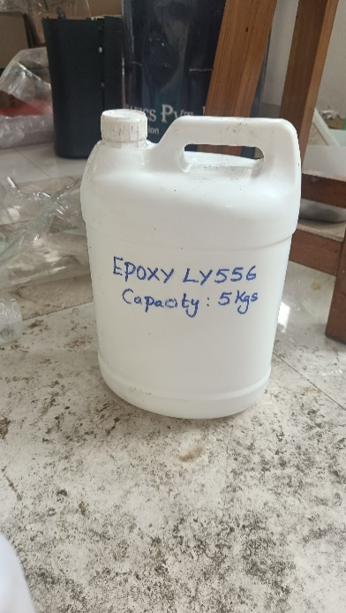
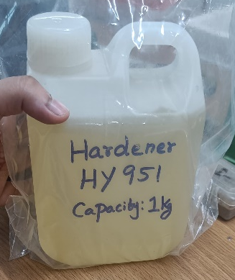

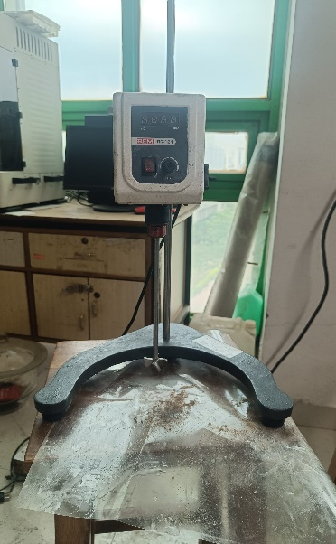
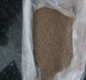
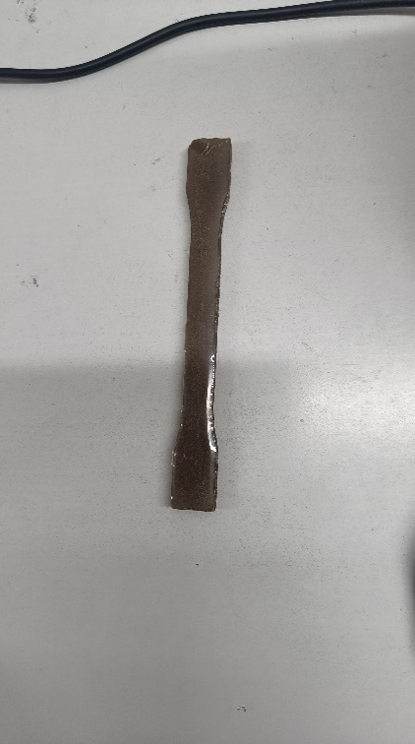
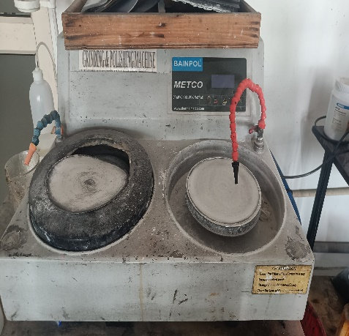
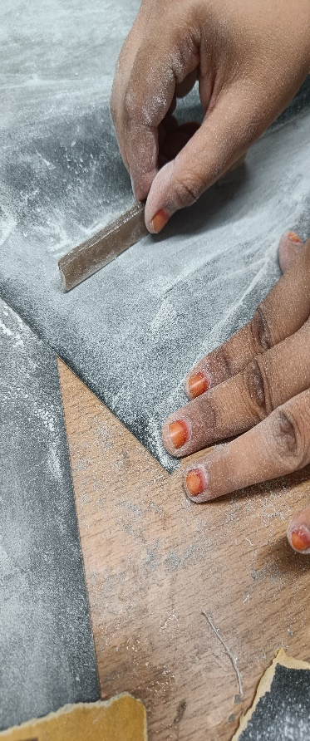
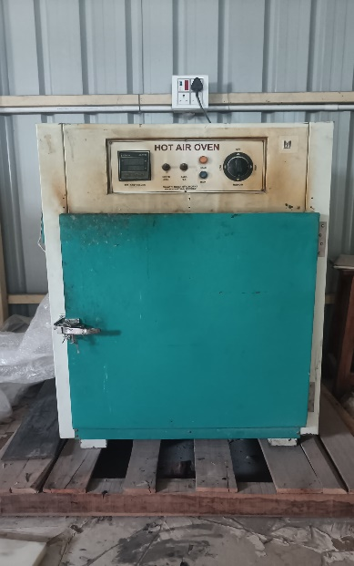
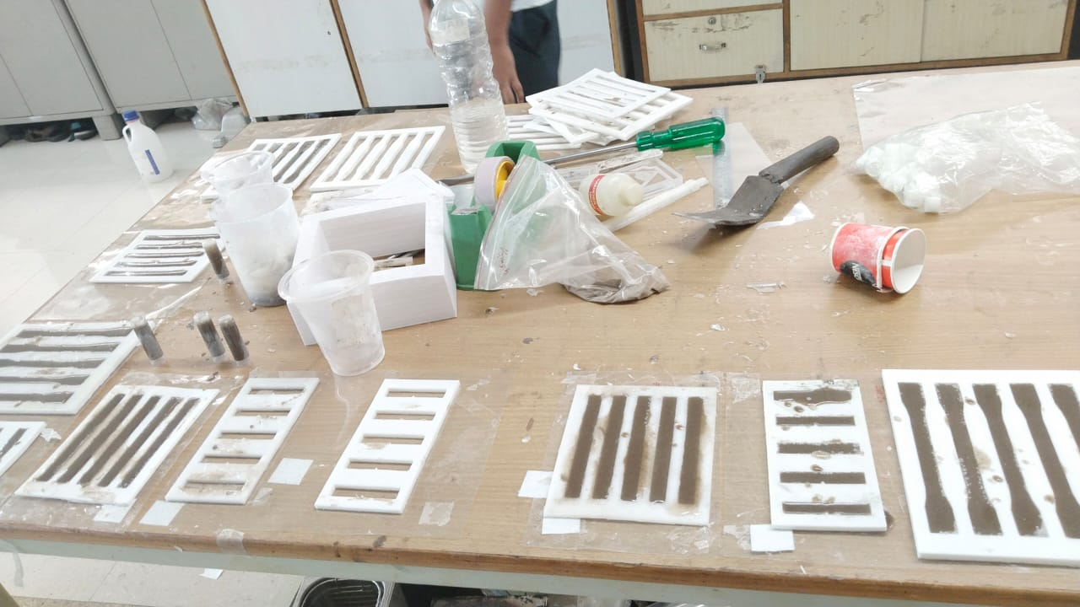
Manufacturing Procedure-2
Sample Preparation
+
+
Epoxy LY556 and Hardener HY951 were chosen
[Miturska]
They were weighed and mixed initially hand stirred in 2:1 ratio for 2-3 minutes.
The mixture was further mixed using overhead stirrer at a speed of 800rpm for 7-8minutes. [Miturska]
Air Dry
for 24hrs
Tensile Samples
The finished samples were polished on a BAINPOL METCO machine at 120 rpm using 220-grit paper.
Samples had been initially finished with 120-grit sandpaper
The specimens were removed from the molds and post-cured in a hot-air oven at 120°C for 12 hours.
The molds were stuck using similar process in phase 1 and mixture was poured

Slide 20













Manufacturing Procedure-2
Experiment- 2
Sand Pre-Processing
150 µm
300 µm
Sun Dry
+Iso Propyl Wash
Dried Sand
Sand
425 µm
Construction Sand was obtained from the same area
The sand was dried in a blast furnace at 140°C for 6 hours to remove residual moisture.
Sand was milled using PULVERISETTE 7, to get particle size < 0.1 μm for precise grain distribution.
Sieving for 15 min using Electrical Sieve Shaker.
600 µm
Mold Preparation
Molds
CAD model of the
Tensile, impact and flexural sample
The molds were 3D-printed with TPU (90% infill) using a 0.4 mm nozzle at 200°C, 60°C bed temperature, and 50 mm/s speed.
Impact Sample Mold
Tensile Sample Mold
Flexural Sample Mold

Slide 21













Manufacturing Procedure-1
Experiment-1
Sand Pre-Processing
Mold Preparation
Air Drying
For 24 hrs
150 µm Sand
Construction Sand was obtained from a nearby area.
Sieving for 15 min using Electrical Sieve Shaker.
CAD model of the
tensile sample
Laser cutting of Silicone rubber sheet
300 µm Sand
Sample Preparation
Add Sand
into mixture
+
Releasing Agent PVA was applied on the OHP sheet
The mold was stuck onto the OHP sheet after the PVA layer had dried
Trans ER099 Epoxy+EH150 Hardener mixture is weighed and hand stirred for 3-5 min
Magnetic stirring was performed with a bead 35x7 mm at 80% of max speed for 7-10 minutes
Mixture was poured into mold and was left for curing for 24 hrs. Sand paper finishing was done

Slide 22
MOTIVATION
Fiber- Reinforced Polymers (FRP’s)
Energy – Absorbing Structures
Functionally Graded Materials (FGMs)
https://doi.org/10.1115/1.4052835
https://doi.org/10.1016/j.compositesa.2016.12.007
https://doi.org/10.1016/j.compstruct.2010.07.008
Superior Protection while maintaining a lightweight profile.
Dissipation of Kinetic Energy over a larger area incorporating effective stacking sequence.
Tailor ability by virtue of constituent elements (Fiber, matrix, etc)
Multi-hit capability and ability to integrate with ceramics with maintaining S-W ratio.
CMFs provide high energy absorption per unit area with good thermal and acoustic insulation.
Corrugated sheets have high bending stiffness and are easily integrable.
Origami and honeycomb structures provide tuneable properties via geometric design with a high S-W ratio.
Novel class of material providing gradients in Material Properties.
Provides improvised shock-impedance characteristics required in different layers combined.
Reduced delamination and improvised multi-hit capability thereby mitigating localized stresses.

